Slide 1
Apple and Samsung
Student name
Institutional affiliation
Course
Date

Slide 2

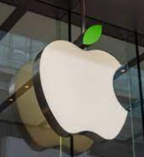
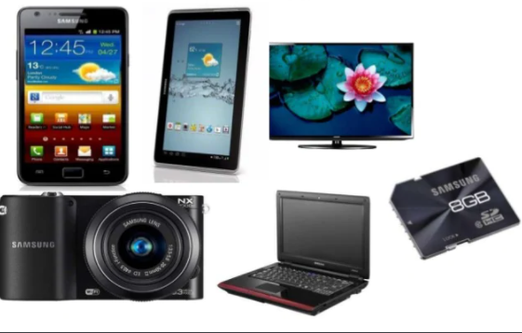
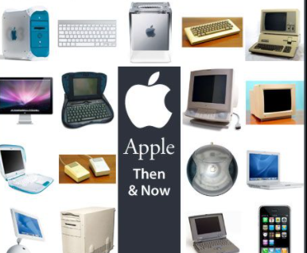

Slide 3
SAMSUNG
Ratios 6.5 | 2017 | 2018 | 2019 | 2020
Current ratio | 2.19 | 2.53 | 2.74 | 2.62
Net profit margin | 0.17 | 0.18 | 0.09 | 0.11
R.O.A | 0.14 | 0.13 | 0.1 | 0.1
Total Asset | 0.79 | 0.72 | 0.65 | 0.63
Inventory turnover | 51.8 | 45.7 | 55.0 | 50.7
Cash ratio | 1.24 | 1.46 | 1.71 | 1.65
Return on equity | 0.65 | 0.18 | 0.82 | 0.74
Receivable turnover | 7.53 | 6.60 | 5.86 | 6.15

Slide 4
ratios | 2017 | 2018 | 2019 | 2020
Current ratio | 2.19 | 2.53 | 2.64 | 1.36
Net profit | 0.17 | 0.18 | 0.09 | 0.21
R.O.A | 0.14 | 0.13 | 0.1 | 0.18
Total asset | 0.79 | 0.72 | 0.63 | 0.85
Inventory turnover | 51.8 | 45.7 | 55.0 | 41.75
Cash ratio | 1.24 | 1.46 | 1.71 | 0.86
Return on equity | 0.68 | 0.18 | 0.82 | 0.88
Receivable turnover | 7.53 | 6.60 | 5.86 | 17.03

Slide 5
Comparison
Ratios | Apple | Samsung
 | 2020
Current ratio | 1.36 | 2.62
Net profit | 0.21 | 0.11
Return on asset | 0.18 | 0.1
Total assets | 0.85 | 0.63
Inventory turnover | 41.75 | 50.7
Cash ratio | 0.86 | 1.65
Return on equity | 0.88 | 0.74
Receivable turnover | 17.03 | 6.15

